Slide 1

Principal Protected Lock-in Notes (PPLIN)
Master of Finance (HKU)
Financial Engineering Project
June , 2007

Slide 2
Team Members

Slide 3
Team Members
(Group No. 13)
1. Clovis So 2005962849
2. Johnny Lee 1994051102
3. Polly Tam 1994046664
4. San Tam 2005962588

Slide 4
Contents
1. Market Overview
2. Underlying Analysis
3. Product Introduction & Return Analysis
4. Components of PPLIN
5. Pricing Methodology
6. Hedging
7. Backtesting
8. Comparison of Ladder with other Options

Slide 5
Target Investors
This product is designed for high risk averse investors who are looking for the potential upside of China Mobile (Stock Code: 941.HK)

Slide 6
Market Trend
Inflation – Interest Rate risk
Carry trade – Dollar/Yen
U.S. second tier mortgage risk
FX – RMB upward trend
Unexpected policy China government
Distort the actual performance of share price by market derivatives

Slide 7
Ladder Option on China Mobile
Why do we need such product?
Lack of market direction
Impact from Chinese government policies
Direction of global interest rate
Risk on market correction
Weighting on China Mobile is heavy under Hang Seng Index

Slide 8
Summary
Ladder option on China Mobile is designed to provide a solid protection for investor
It also provide a lock up profit for investor no matter how the market performs

Slide 9
The Underlying of the Ladder Options
China Mobile
中國移動 (941-HK)

Slide 10
China Mobile 中國移動 (941-HK)
Leading mobile services provider in Mainland China
World's largest unified contiguous all-digital mobile network
World's largest mobile subscriber base: an aggregate mobile telecommunications subscriber base of over 301.2 million

Slide 11
China Mobile 中國移動 (941-HK)
Market share of approximately 67.5 per cent
Healthy financial figures and ratios:
  Market capitalization: 1,515,593 M
  Operating Revenue: RMB295,358 M (up 21.5%)
  Profit: RMB66,026 M (up 23.3%)
  Profit margin: 22.4%
  Earnings per share: RMB3.32 (up 22.5%)
  PE ratio: 22.62

Slide 12
China Mobile 中國移動 (941-HK)
Continuous rapid growth of subscribers
Total Subscribers
(Million)
Net Additional Subscribers
(Million)
22.1%
25.6%
301.232
53.221
20.7%
11%
246.652
42.360
204.292
38.179
66%
68%
73%
78%
64%
64%
2004.12
2005.12
2006.12
2004
2005
2006
Market share
Net adds market share

Slide 13
China Mobile 中國移動 (941-HK)
Sustained profit growth
Operating Expense
(RMB Billion)
Net Profit
(RMB Billion)
20.0%
23.3%
18.8%
203.230
24.7%
66.026
169.355
53.549
142.600
42.952
69.9%
69.7%
68.8%
21.1%
22.0%
22.4%
2004
2005
2006
2004
2005
2006
Operating expense/Operating Revenue
Net Profit Margin
Favorable revenue growth
Effective cost control
Sustained profit growth

Slide 14
China Mobile 中國移動 (941-HK)
3G will be the earnings momentum
  Adhering to the principles of integrated planning and gradual implementation, actively carrying out preparation of planning and construction
  Actively conducting marketing strategy research and preparing new products and services to fully gear up for 3G commercialization
  Fully utilizing 2G resources to achieve a smooth migration from 2G to 3G and their long term co-existence in the network

Slide 15
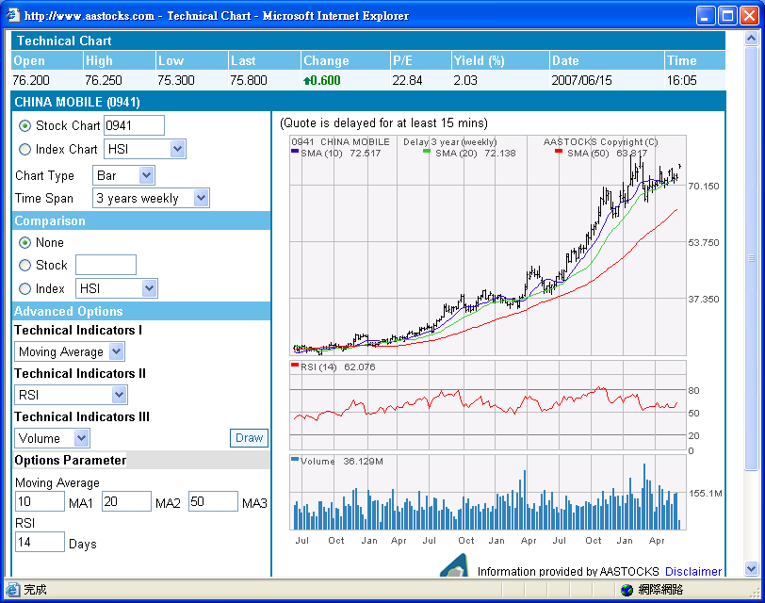

Price Trend of China Mobile

Slide 16
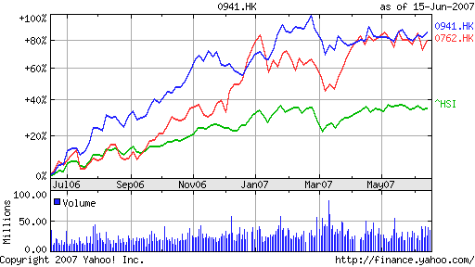
China Mobile vs China Unicom

Slide 17
Sample Termsheet of PPLIN

Slide 18

Characteristics of PPLIN
Maturity: 2Y
Currency: HKD
Underlying: 941 HK (China Mobile Ltd)
Payoff at Maturity:
  100% Capital Protected plus :
    If S_{Max} = S_{T} , is above the highest barrier = PR * Performance of S_{Max}, Otherwise;
    If S_{Max} touched any barriers = PR * Performance of the highest barrier level reached, otherwise,
    If S_{T} is above strike level, = PR * Performance of S_{T,}

Slide 19
Return on the PPLIN

Slide 20
Return on the PPLIN
The return to the investor will be illustrated by 3 scenarios
  Spot price: $75.8
  First ladder level : $83.4 (110% * Spot)
  Second ladder level: $91.0 (120% * Spot)
  Participation Rate (PR): 0.5
  Initial investment: $100
  Tenor: 2 years

Slide 21
Return on PPLIN: Scenario 1
China Mobile hits first ladder level ($83.4) and closing at below first ladder level ($81.8) after 2 years

Slide 22
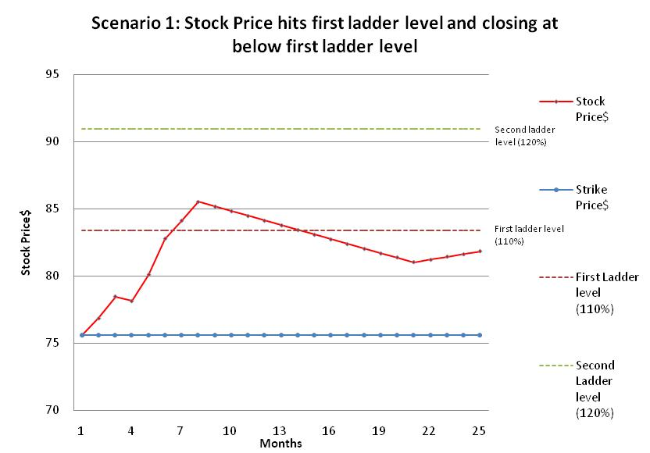
Return on PPLIN: Scenario 1

Slide 23
Return on PPLIN: Scenario 1
In general: Initial investment + Participation rate * (Max (0, Sm – K, Li – K)
  Sm: Spot price at maturity
  Li: Ladder level reached during the term of the option
Since China Mobile hits the first ladder, pay-off to the investor = sum of 1. and 2.
  Initial investment: 100
  PR * ( L1 – K): 0.5 * (83.4 – 75.8) = 3.8
Total settlement value: 103.8

Slide 24
Return on PPLIN: Scenario 2
China Mobile hits first ladder ($83.4) and second ladder level ($91.0) and closing at below first ladder level ($74.74) after 2 years

Slide 25
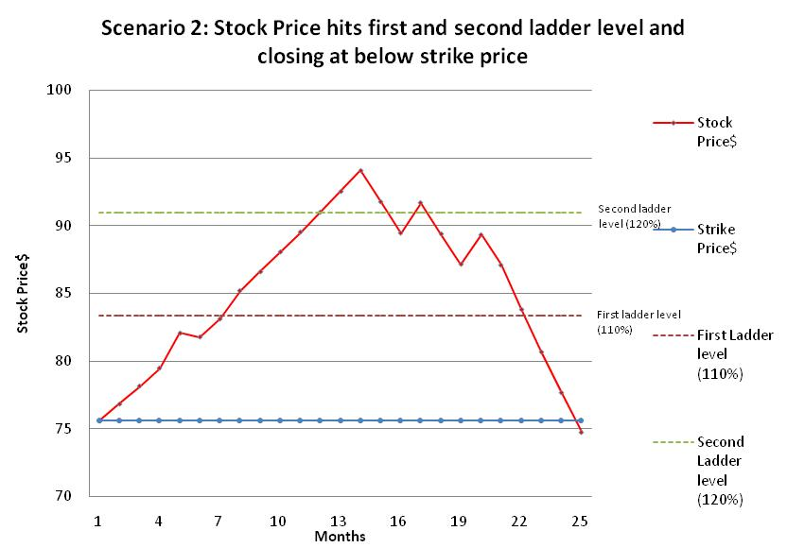
Return on PPLIN: Scenario 2

Slide 26
Return on PPLIN: Scenario 2
In general: Initial investment + Participation rate * (Max (0, Sm – K, Li – K)
  Sm: Spot price at maturity
  Li: Ladder level reached during the term of the option
Since China Mobile hits the 2nd ladder, pay-off to the investor = sum of 1. and 2.
  Initial investment: 100
  PR * ( L2 – K): 0.5 * (91.0 – 75.8) = 7.6
Total settlement value: 107.6

Slide 27
Return on PPLIN: Scenario 3
China Mobile hits first ladder ($83.4) and second ladder level ($91.0) and closing at above the second ladder level ($94.36) after 2 years

Slide 28
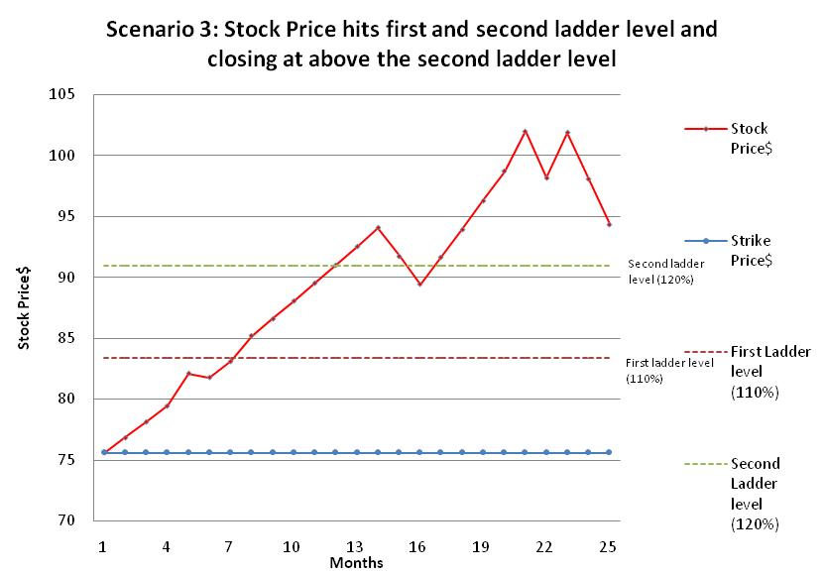
Return on PPLIN: Scenario 3

Slide 29
Return on PPLIN: Scenario 3
In general: Initial investment + Participation rate * (Max (0, Sm – K, Li – K)
  Sm: Spot price at maturity
  Li: Ladder level reached during the term of the option
Since China Mobile hits the 2nd ladder and closing above 2nd ladder, pay-off to the investor = sum of 1. and 2.
  Initial investment: 100
  PR * ( Sm – K): 0.5 * (94.4 – 75.8) = 9.3
Total settlement value: 109.3

Slide 30
Components of the PPLIN

Slide 31
Decomposition of the PPLIN
PPLIN = Zero Coupon Bond + Participation Rate X Ladder Option
Zero Coupon Bond will ensure the product has a payoff at 100% of the investment at maturity. (Capital Guaranteed!)
The Ladder Option on the other hand will generate extra profits if stock price goes up.

Slide 32
Constructing the payoff for stock price reaches 110% (1st Barrier)
1) Long 1 European Call, K=100%
Payoff
30
20
10
S
100
110
120
130
Notes:
Fhfdslkjfkl
kdkl

Slide 33
Long 1 European Call, K=100%
Long 1 Up & In Put, K=110%, KI=110%
Payoff
Payoff
20
20
10
10
S
S
100
110
120
100
110
120

Slide 34
Long 1 European Call, K=100%
Long 1 Up & In Put, K=110%, KI=110%
Short 1 Up & In Put, K=100%, KI=110%
Payoff
Payoff
20
20
10
10
S
S
100
110
120
100
110
120
-10

Slide 35
Long 1 European Call, K=100%
Long 1 Up & In Put, K=110%, KI=110%
Short 1 Up & In Put, K=100%, KI=110%
Payoff
Payoff
20
20
10
10
S
S
100
110
120
100
110
120
-10

Slide 36
Payoff
Long 1 European Call, K=100%
Long 1 Up & In Put, K=110%, KI=110%
Short 1 Up & In Put, K=100%, KI=110%
30
20
10
S
100
110
120
130
When stock price reached 110% of spot price, the Ladder Option will have exactly the payoff diagram shown above.
Even when stock price drops again in later time, the payoff would still, at least, be 10%. (ie, the 10% profit is locked!)

Slide 37
Constructing the payoff for stock price reaches 120% (2nd Barrier)
Long 1 European Call, K=100%
Long 1 Up & In Put, K=110%, KI=110%
Short 1 Up & In Put, K=100%, KI=110%
Payoff
30
20
10
S
100
110
120
130

Slide 38
Long 1 European Call, K=100
Long 1 Up & In Put, K=110%, KI=110%
Short 1 Up & In Put, K=100%, KI=110%
Long 1 Up & In Put, K=120%, KI=120%
Payoff
Payoff
20
20
10
10
S
S
110
120
130
110
120
130

Slide 39
Long 1 European Call, K=100
Long 1 Up & In Put, K=110%, KI=110%
Short 1 Up & In Put, K=100%, KI=110%
Long 1 Up & In Put, K=120%, KI=120%
Short 1 Up & In Put, K=110%, KI=120%
Payoff
Payoff
30
30
20
20
S
S
110
120
130
110
120
130
-10

Slide 40
Long 1 European Call, K=100
Long 1 Up & In Put, K=110%, KI=110%
Short 1 Up & In Put, K=100%, KI=110%
Long 1 Up & In Put, K=120%, KI=120%
Short 1 Up & In Put, K=110%, KI=120%
Payoff
Payoff
30
30
20
20
S
S
110
120
130
110
120
130
-10

Slide 41
Payoff
Long 1 European Call, K=100
Long 1 Up & In Put, K=110%, KI=110%
Short 1 Up & In Put, K=100%, KI=110%
Long 1 Up & In Put, K=120%, KI=120%
Short 1 Up & In Put, K=110%, KI=120%
40
30
20
S
110
120
130
140
When stock price reached 120% of spot price, the Ladder Option will have exactly the payoff diagram shown above.
Even when stock price drops again in later time, the payoff would still, at least, be 20%. (ie, the 20% profit is locked!)

Slide 42
The structure of Ladder Option
That is actually a European Call plus series of Up & In Put Options.
+ 1 Call
+ 1 Up & In Put, K=110%, KI=110%
- 1 Up & In Put, K=100%, KI= 110%
+ 1 Up & In Put, K=120%, KI=120%
- 1 Up & In Put, K=110%, KI=120%
+ 1 Up & In Put, K=130%, KI=130%
- 1 Up & In Put, K=120%, KI=130%
+ 1 Up & In Put, K=140%, KI=140%
- 1 Up & In Put, K=130%, KI=140%
.
.
.

Slide 43
Pricing Methodology

Slide 44
Pricing - Decomposition
PPLIN can be decomposed into 3 major components
2 years zero coupon bonds
Call option
Up and In Put (At different barrier and strike)
Closed form solution based on BS is available

Slide 45
Pricing – Zero coupon bonds
Long 2 years zero coupon bonds
Price = PV of Par with maturity at 2 years, discounted at 2 yrs HIBOR of 4.696%
Spot price = 100 / (1 + 4.696)^2 = 91.23

Slide 46



Pricing – Call option / Up-in put
According to Robert L. McDonalds

Slide 47
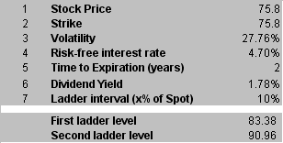
Pricing – Ladder option
Pricing assumptions

Slide 48
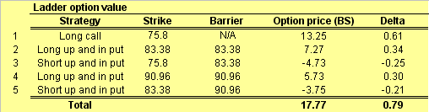
Pricing – Ladder option
Pricing Results

Slide 49
Hedging

Slide 50
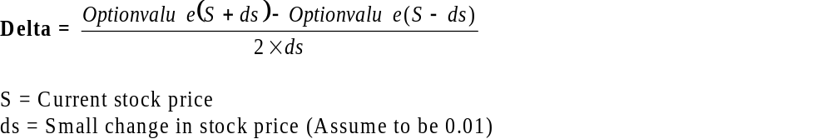
Delta Hedging
Delta Formula
Delta for ladder options = Sum of Delta of the component options

Slide 51
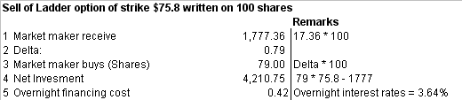
Delta Hedging - Example
Day 0 – Sell of ladder options of strike $75.8 written on 100 shares

Slide 52
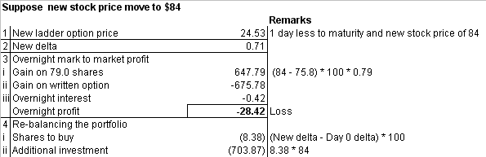
Delta Hedging - Example
Day 1 – China Mobile moves to $84

Slide 53
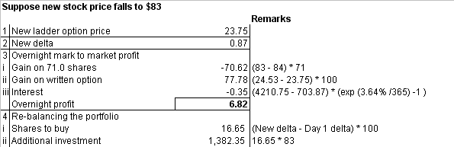
Delta Hedging - Example
Day 2 – China Mobile moves down to $83

Slide 54
Backtesting

Slide 55
Backtesting of the PPLIN
Backtesting is usually conducted to provide an additional information and reference to help investor understand more about the product.
The Backtesting conducted for PPLIN is gathered real market data from the period of 01 Jan 2003 – 15 June 2007.

Slide 56
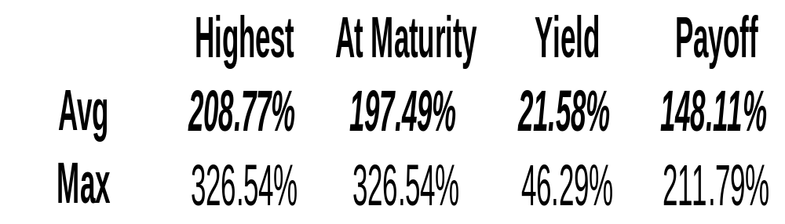
Backtesting of the PPLIN
The result with in this period shows :

Slide 57
Comparison – European Call, Ladder Option & Lookback Option

Slide 58
Pricing – Comparison (1)
The Payoff Diagram of a European Call.
Payoff
S

Slide 59
Pricing – Comparison (1)
If a Ladder Option with a very high Barrier set at a very high level, it will have the following Payoff Diagram
Payoff
S

Slide 60
Pricing – Comparison (1)
Comparing the two option Payoff Diagrams, indeed, they both have a very similar payoff. Therefore, we may assume they should have roughly the same price.
Call
Ladder Call
Payoff
Payoff
B
S
S

Slide 61
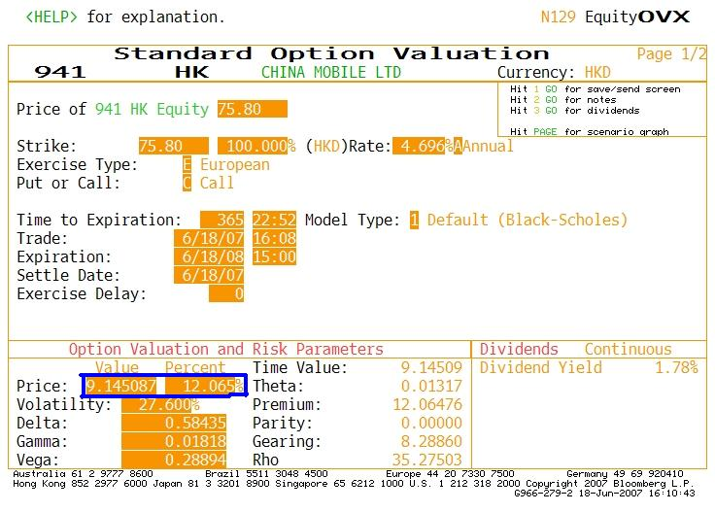
Pricing – Comparison (1)
By using the Bloomberg Calculator, we found out the following.
For Call = 12.065%

Slide 62
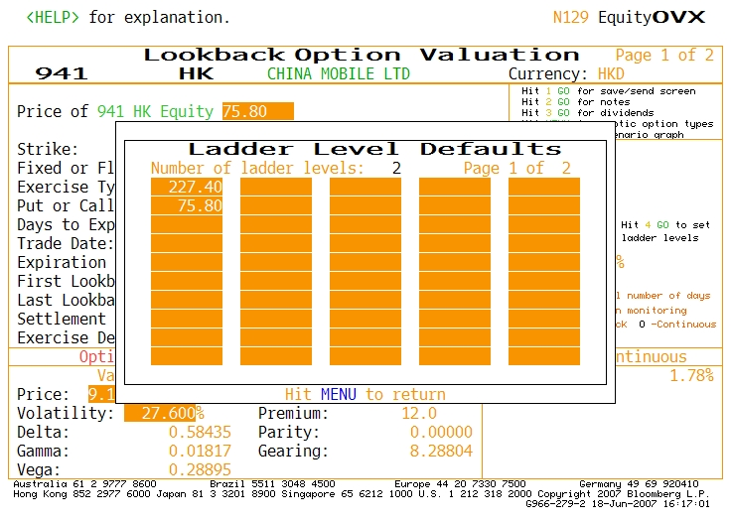
Pricing – Comparison (1)
For Ladder Option, the Barrier is set to be very hight like 300%

Slide 63
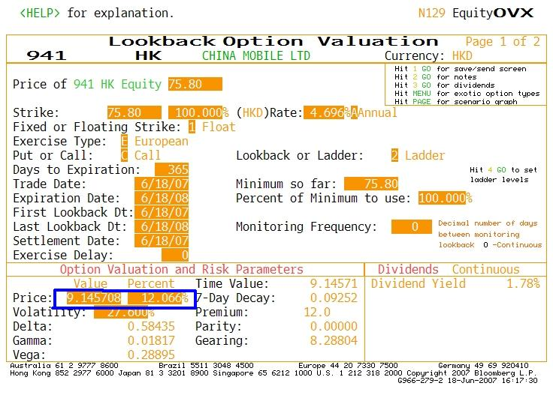
Pricing – Comparison (1)
In fact, the Ladder Option price = 12.066%

Slide 64
Pricing – Comparison (2)
Comparing the prices,
Call = 12.065%
Ladder Call = 12.066%
Which matches the assumption mentioned earlier.

Slide 65
Pricing – Comparison (2)
A Lookback Option has the payoff = Max [0, S_{Max} – K]
S
S_{Max}
T

Slide 66
Pricing – Comparison (2)
If a Ladder Option with many barriers and the intervals between the barriers is small. The payoff should be very close to the Lookback Option.
S
B_{n}
T

Slide 67
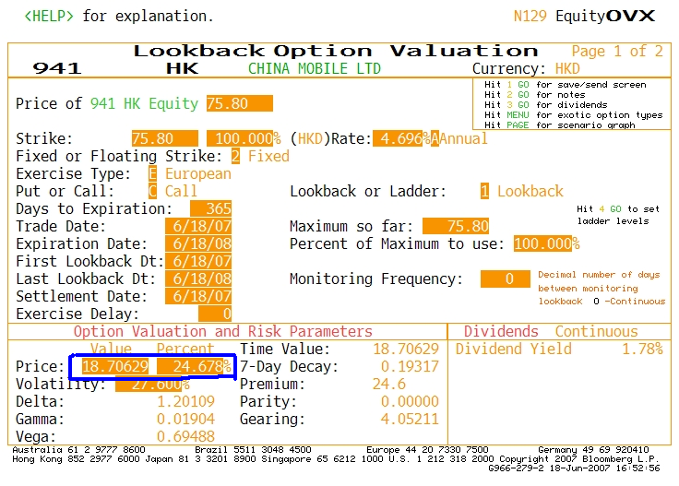
Pricing – Comparison (2)
By using the Bloomberg Calculator, we found out the following.
For Lookback = 24.678%

Slide 68
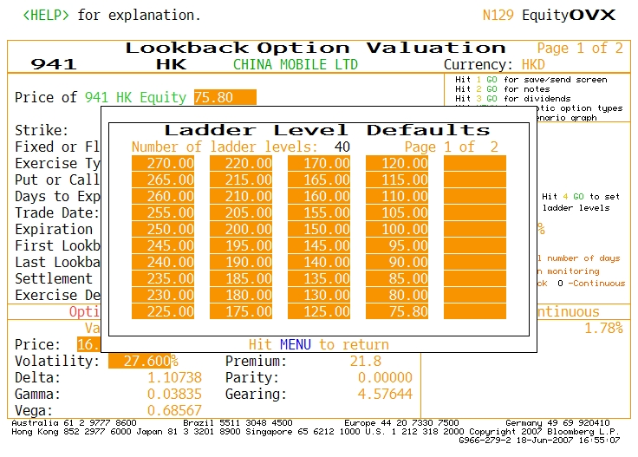
Pricing – Comparison (2)
For Ladder Option, with many Barriers.

Slide 69

Pricing – Comparison (1)
In fact, the Ladder Option price = 21.851%

Slide 70
Pricing – Comparison (2)
Comparing the prices,
Lookback = 24.678%
Ladder Call = 21.581%
Which matches the assumption mentioned earlier.

Slide 71
Pricing – Comparison
From the above experiment & intuitive thinking, we can conclude that with the same underlying, maturity and other parameters, the price relationship =
Call Option < Ladder Option < Lookback Option

Slide 72
The End

